Slide 1



Builder Pattern
Creational Design Pattern
Brought to you by:
Bacotiu Denisa-Cristina
Adam Sergiu-Radu
Alb Dan-Cristian

Slide 2
Basic concepts and principles
Builder Pattern appeared as a solution to the need to simplify the creation process of complex objects
The pattern acts by separating the creation of an object from its representation. As a result, the same construction process can create different representations.
Object creation is an step-by-step process and the final step represents the return of the created object

Slide 3
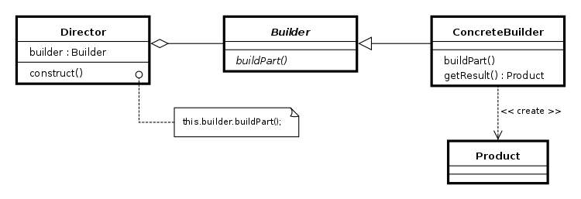
Class Diagram

Slide 4
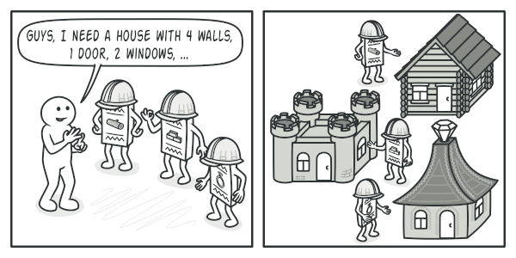
Product
A class that defines the way our complex object that is to be generated with the help of the builder pattern will get its characteristics from.
Products are resulting objects. Products constructed by different builders don’t have to belong to the same class hierarchy or interface.
As an example, look in how many ways a complex object like a house can be.

Slide 5
Builder
It is an abstract class that has the specific abstract methods that are representing the steps for correctly building an object of type “Product”
The actual functionality of the presented steps via the abstract methods is carried out in the concrete subclasses (ConcreteBuilder).
Depending on the used programming language, the Builder class can be replaced with an interface.

Slide 6
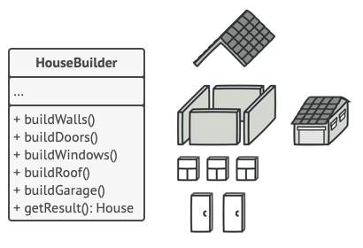
Concrete Builder
The concrete builder is a subclass of the abstract Builder class and it provides the functionality to create a complex product with its particular characteristics.
The number of such classes is not restricted and it varies based on the used representations of the product.

Slide 7
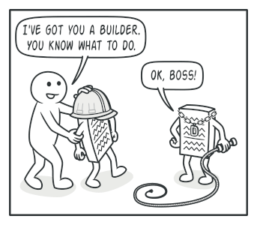
Director
The director class defines the order in which to execute the building steps, while the builder provides the implementation for those steps.
The director is responsible to hide the details of product construction from the client code.
The client is responsible to associate a builder with a director, start the object construction with the director and get the final result from the builder.

Slide 8
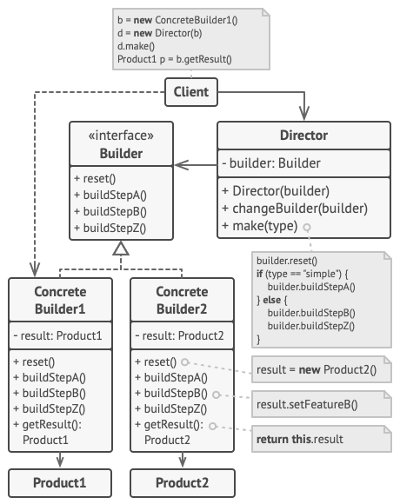
A better understanding of the pattern

Slide 9

Guava
Google Core Libraries for Java
Guava is a set of core libraries that includes new collection types (such as multimap and multiset), immutable collections, a graph library, functional types, an in-memory cache, and APIs/utilities for concurrency, I/O, hashing, primitives, reflection, string processing, and much more.
GitHub Repository:
https://github.com/google/guava
License:
Apache 2.0

Slide 10
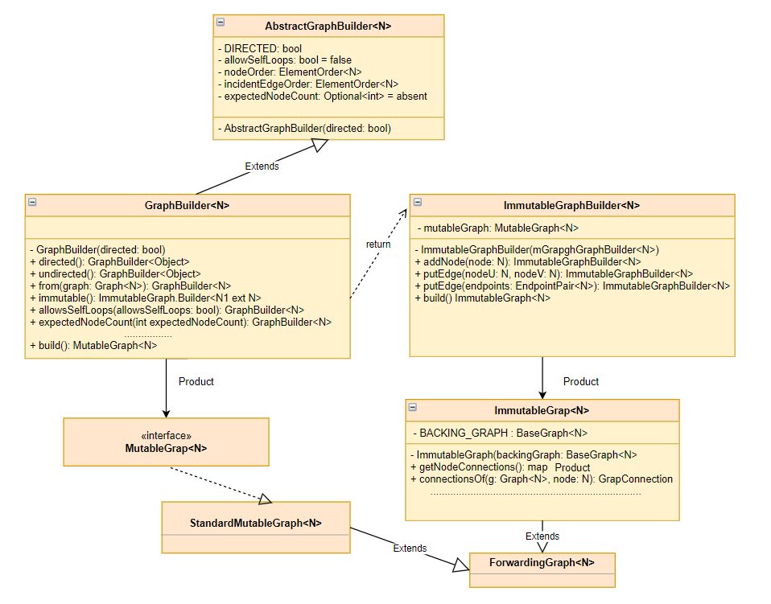
Builder Pattern in open source software

Slide 11
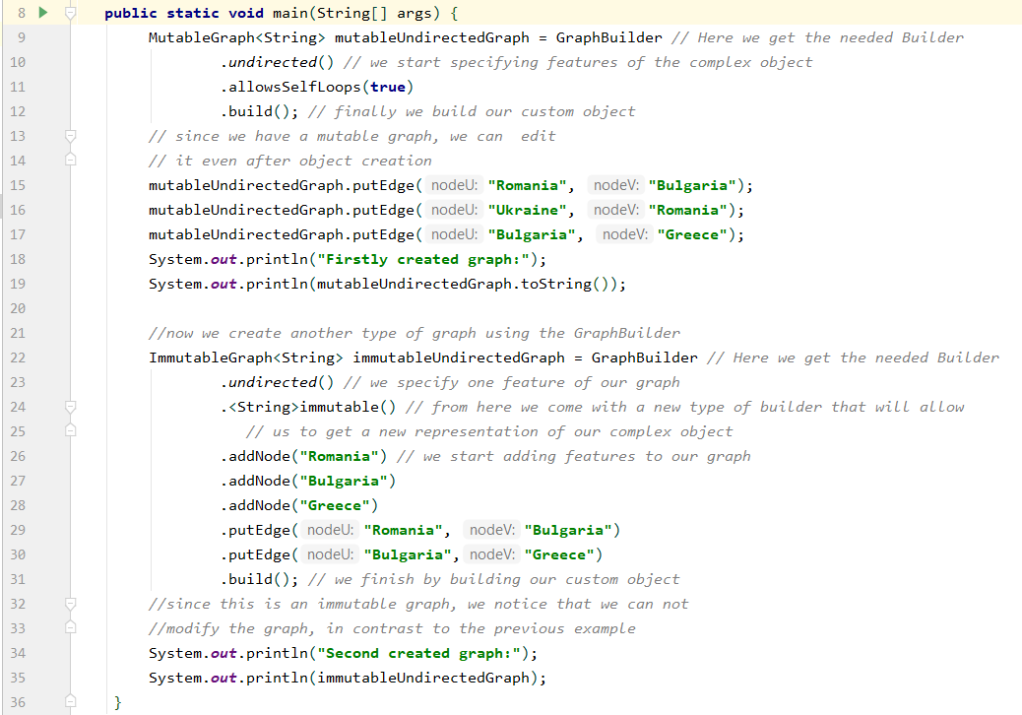
Pattern in action

Slide 12

OkKttp
OkHttp is an HTTP client that’s efficient by default:
  HTTP/2 support allows all requests to the same host to share a socket.
  Connection pooling reduces request latency (if HTTP/2 isn’t available).
  Response caching avoids the network completely for repeat requests.
Using OkHttp is easy. Its request/response API is designed with fluent builders and immutability. It supports both synchronous blocking calls and async calls with callbacks.
GitHub:
https://github.com/square/okhttp

Slide 13
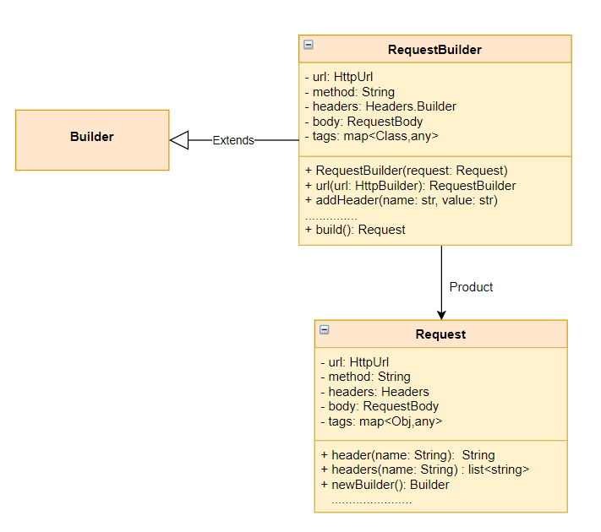
Builder Pattern applied in Http Request construction

Slide 14
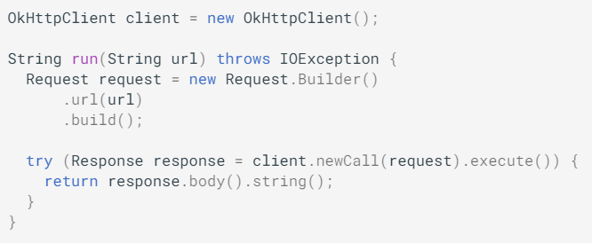
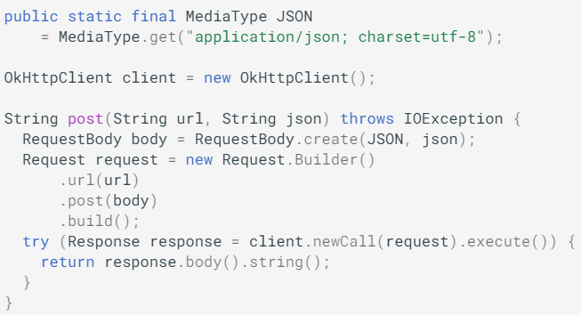
Request Builder in Action
Perform a Get Request
Perform a Post Request

Slide 15
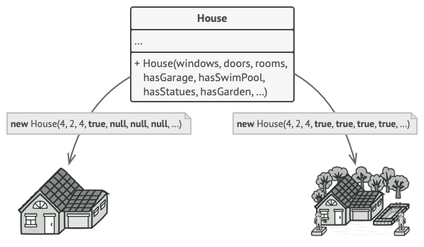
Why using the Builder Pattern?
Object construction is a step-by-step process
One may reuse the same construction code when building various representations of products
It follows the Single Responsibility Principle. We isolate the complex object construction code from the business logic of the product
Some Drawbacks of this pattern
the overall complexity of the code increases since additional classes are required

Slide 16
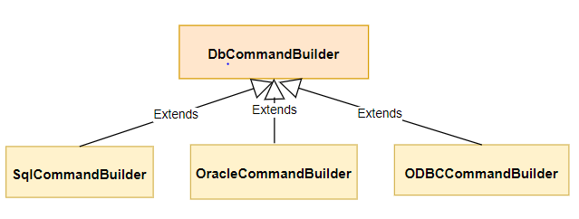
Builder Pattern and other Applications 1
Ado.NET
Builder Pattern applied for Database Commands
GitHub Repository:
  https://github.com/microsoft/referencesource
Already Interacted with it at Database Management Systems Class

Slide 17
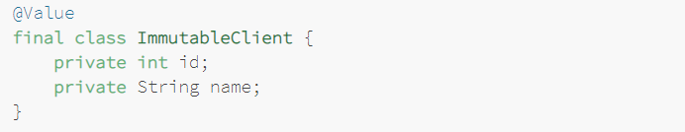
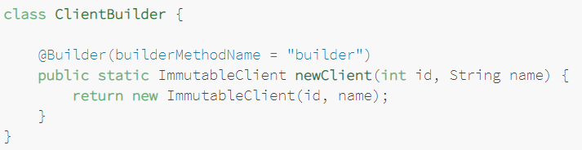
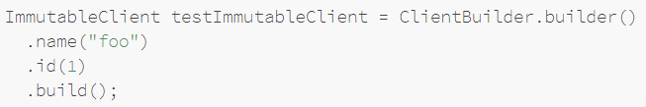
Builder Pattern and other Applications 2
Project Lombok
Homepage:
    https://projectlombok.org/
@Builder Annotation automatically generates a Builder for your Model Objects.
Its aim is to reduce boilerplate code
Already used at the Systems for Design and Implementation Class

Slide 18
References
https://en.wikipedia.org/wiki/Builder_pattern
https://refactoring.guru/design-patterns/builder
https://opensource.google/projects/guava
https://square.github.io/okhttp/
https://www.baeldung.com/lombok-builder

Slide 19
Thank you for your attention

